Slide 1
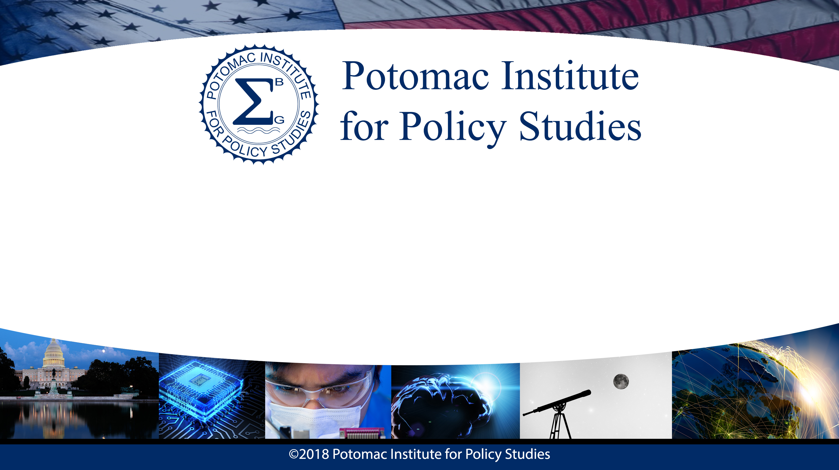
Engineering a Competitive Future
Claire Spina
8/8/2018

Slide 2
Imagine a world…
Militaries worldwide deploy genetically enhanced combatants
Insurgents within the U.S. have modified their own genomes
These enhanced humans are stronger, faster, smarter
U.S. is no longer a major military power because its soldiers are unmodified

Slide 3
The Future May Not Be So Distant
Gene
Editing
China engineered 2x more muscular dogs in 2015
Same principle could be used to produce extraordinarily strong humans
Chinese Academy of Military Medical Sciences and Third Military Medical University both sponsor CRISPR research

Slide 4
How Do We Measure Up?
China
CRISPR gene editing trials in humans since 2015
9+ trials
86 patients treated
U.S.
One gene editing trial approved to start in 2018
FDA has placed clinical hold
Another has stalled for unknown reasons
The U.S. is falling behind.

Slide 5
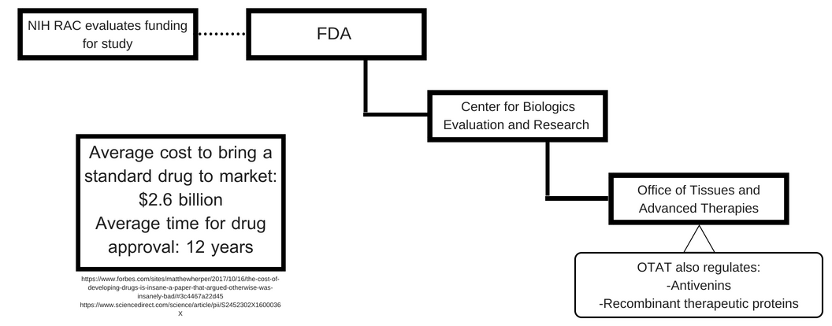
Current Regulatory Process

Slide 6
Results of an Unfocused System
20 years for AquAdvantage salmon to get FDA approval
6 years to allow trial for Oxitec mosquitos- then regulation transferred to EPA
19% drop in CRISPR Therapeutics stock following FDA hold
System favors larger companies who know how to navigate process, small innovators driven out, limits technological advancement

Slide 7
Moving Forward: A Balancing Act
Efficiency
Help people, cure diseases
Sufficient legislation
Oversight
Safety
Avoid eugenics
Avoid conflicting legislation
Ability to function
How can the U.S. keep this balance and remain competitive in a rapidly developing field?

Slide 8
Recommendation #1
Create new center within FDA focused specifically on regulating human gene editing
  FDA process already slow and costly
  Gene editing is currently regulated in a small subdivision, but has the potential to drastically alter healthcare and humanity
  Framework of new center should be established specifically to deal with gene editing, to avoid the long delays associated with earlier applications
  Greater efficiency, encouraging greater innovation

Slide 9
Recommendation #2
Devote greater NIH funding to improving gene editing techniques
  NIH Somatic Cell Editing program investing $190 million over next 6 years
  $31.6 million/year
  NIH budget: approx. $37.3 billion annually
  Percentage going to gene editing: 0.085%
  The next CRISPR?
  Increased funding will help offset costs of innovation and development, help keep the U.S. competitive internationally

Slide 10
Thank You
Questions?

Slide 11
Sources
Slide 3
https://www.cnn.com/2015/10/28/world/china-mutant-dogs-genetic-engineering/index.html
Slide 4
https://www.npr.org/sections/health-shots/2018/02/21/585336506/doctors-in-china-lead-race-to-treat-cancer-by-editing-genes
https://labiotech.eu/medical/crispr-therapeutics-fda/
Slide 5
https://osp.od.nih.gov/biotechnology/faq-onthe-nih-review-process-for-human-gene-transfer-trials/
https://www.fda.gov/aboutfda/centersoffices/officeofmedicalproductsandtobacco/cber/ucm471141.htm
https://www.forbes.com/sites/matthewherper/2017/10/16/the-cost-of-developing-drugs-is-insane-a-paper-that-argued-otherwise-was-insanely-bad/#7e724e6a2d45
https://www.sciencedirect.com/science/article/pii/S2452302X1600036X
Slide 6
http://thehill.com/opinion/healthcare/358893-current-fda-approach-to-genetically-engineered-animals-is-flawed
https://www.wired.com/story/oxitecs-genetically-modified-mosquitoes-are-now-the-epas-problem/
https://www.bloomberg.com/news/articles/2018-05-30/gene-therapy-company-crispr-drops-after-fda-puts-hold-on-trial
Slide 9
https://www.nih.gov/news-events/news-releases/nih-launch-genome-editing-research-program
https://www.nih.gov/about-nih/what-we-do/budget

